Slide 1
Power Through Partnership
Statewide conference
Thursday, September 28, 2017

Slide 2
Powered by

Slide 3
Who We Are
New York State’s largest network of professional, unbiased, nonprofit homeownership advisors.
Founded in 2006
81 member agencies
7 Regional Chapters
4 Committees

Slide 4
Sponsors
Citi
SONYMA
Freddie Mac
M&T Bank
Federal Home Loan Bank of New York
JPMorgan Chase Bank
Fannie Mae
Key Bank
TD Bank
NeighborWorks America

Slide 5
Conference Planning Committee
Michelle DiBenedetto, co-chair
Eileen Anderson
Kathy Germain
Karyn Hausknecht
Ellie Pepper
Sherri Eckles, co-chair
Lucy Raimes
Sandy Becker
Susan Belanich
Robert McCool
Andrea Haughton

Slide 6
Board of Directors – Chapter Representatives
Christian Moriarty – American Debt Crisis – Long Island
Charles Butler – Harlem Congregations for Community Improvement – NYC
Kathy Germain – RUPCO – Hudson Valley
Tracy Gibeau – Albany County Rural Housing Alliance – Capital District
Christine Lennon – HomeOwnershipCenter UNHS – Central NY
Shawn Blauvelt – Keuka Housing Council – Rochester/Finger Lakes
Sandy Becker – Belmont Housing – Western NY

Slide 7
Board of Directors – At-Large Delegates
Michelle DiBenedetto – Long Island Housing Partnership
Lucy Raimes – Center for NYC Neighborhoods
Robert McCool – Neighbors Helping Neighbors

Slide 8
Board of Directors – Officers
Michelle Di Benedetto – President
Christian Moriarty – Vice President
Charles Butler – Secretary
Sandy Becker - Treasurer

Slide 9
Committee Member Chairs
Chapter Services – Courina Yulisa
Advocacy – Sue Cotner
Program & Business Development – Hilary Lamishaw & Sue Cotner

Slide 10
Committee Board Chairs
Chapter Services – Michelle Di Benedetto
Advocacy – Christian Moriarty
Governance – Michelle Di Benedetto
Program & Business Development – Charles Butler

Slide 11
Partnerships
Housing Counselors
Legal Service Providers
Advocacy Organizations
Lenders
Servicers
Realtors
State and Local Government
Foundations & Funders

Slide 13
Values of Professional Networking
Expand Knowledge
1
Leverage Relationships
2
Access Funding
3
Increase
Power
4

Slide 14
Expand Knowledge
HomeSmartNY
Listserv &
Webinars
HomeSmartNY Chapter Trainings, Webinars & Conference
HomeSmartNY
Listserv
HomeSmartNY
Chapter Trainings
HomeSmartNY Sponsored Place-Based Trainings
Awareness of innovations and changes in Housing Counseling
Access Professional Training & Career Development
Share Professional Knowledge and Information with Colleagues
Receive Continuing Education Credits Toward Professional Accreditation
Obtain Professional Accreditation

Slide 15
Leverage Relationships
HomeSmartNY
Chapters, Committees & Conference
HomeSmartNY
Chapters, Committees & Conference
HomeSmartNY
Chapters, Committees & Conference
HomeSmartNY
Chapters, Committees & Conference
HomeSmartNY
Chapters, Committees & Conference
Partner with Others to Increase your Reach
Access New Programs and Opportunities
Meet Housing Counseling Stakeholders
Leverage Resources with other NonProfits
Develop New Relationships with Foundations & Funders

Slide 16
Access Stakeholders& Partners
HomeSmartNY
Chapters, Committees & Conference
HomeSmartNY
Chapters, Committees & Conference
HomeSmartNY
Listserv,
Chapters, Committees & Conference
HomeSmartNY
Program & Business Development Committee
HomeSmartNY
eHome America
Know the Decision Makers
Participate in Programs & Partnerships
Access Funding & Revenue Sources
Develop New Programs, Partnerships & Funding Sources
Receive Discounts in Network Shared Programs

Slide 17
Increase Power
HomeSmartNY
Committees &
Chapters
HomeSmartNY Chapters
HomeSmartNY
Committees
HomeSmartNY Partnership with NHRC
HomeSmartNY
Committees, Chapters & Conference
Collaborate with Like-Minded Organizations
Advocate Locally
Advocate on the State Level
Advocate on a National Level
Increase Your Organization’s Name Recognition

Slide 18
Current Programs & Projects
SONYMA Partnership
New York State Association of Realtors Partnership
Advocacy Campaign – Beyond HOPP
Quarterly Membership Calls
Local Training Opportunities – Partnership with RCAC
eHome America Online Education
Online Member Search Engine

Slide 19
Under Development…
eHome America Post-Purchase Education
Partnering with Insurance Companies
Realtor Continuing Education Credit Class
Pre-purchase Referral System
Expanded Participation in SONYMA Programs
Nationwide Mortgage Collaborative

Slide 20
Be an Active Member
Like Us https://www.facebook.com/homesmartny
Follow Us https://twitter.com/HomeSmartNY
Share our social media. We will share yours too
Review and update your organization’s information
Sign up for eHome America
Volunteer for a Committee
Be active in your Chapter
Renew your membership for 2018

Slide 21
Power Through Partnership
Statewide conference
Thursday, September 28, 2017

Slide 22
Meet Your Partnership Panelists
Jason Jefferies, Affordable Lending Regional Manager – North East, Freddie Mac
Raymond Leech, Community Lending CDT, Fannie Mae
Edward Bartholomew, President, EDC Warren County
Charles Kilbourne, Trustee, The Wright Family Foundation

Slide 23
Jason Jefferies Affordable Lending Regional Manager – North East Freddie Mac

Slide 24
Sustainable Affordable Lending Programs
March, 2017

Slide 25
What’s Happening in the Housing Market?
Household Demographics
Household formations: 1.3 million in 2015, up from 653,000 in 2013
Millennials living with parents: ~1/4
Millennial households: 16 million in 2015, rising to 40 million in 2025
Minorities share of household growth 2015-2025: 75%
Households aged 70+: ↑8 million (40%) from 2015-2025
Housing Market Environment
Good news:
Economy, employment, wages growing – but slowly
Housing starts increasing
1 million homeowners regained positive equity in 2015
Strong belief in homeownership
Not-so-good news:
Lending myths abound
Low inventory
Rising home prices
Rising interest rates
Source: Joint Center for Housing Studies of Harvard University’s “2016 State of the Nation’s Housing”

Slide 26
Millennials Dominate the Conversation
83+ million of them
26.3 years old on average
$51,000 average annual income
14% with mortgages
Creditworthiness (VantageScore® 3.0) | Percentage of Millennials
Strong (>737) | 14%
Moderate (661-736) | 19%
Weak (<661 +/or other setbacks) Near-moderate 601-660 Near-moderate <601 | 50% 29.1% 70.6%
24 million are mortgage-ready
now
Sources: Experian data, Freddie Mac analysis

Slide 27
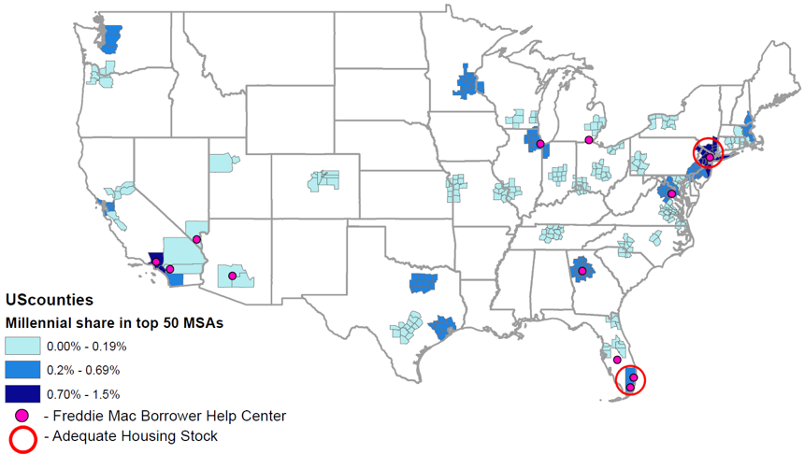
Where Are the Greatest Concentrations of Mortgage-ready Millennials?
50 Metro Areas with the Highest Percentage of Millennials
Sources: Experian, Redfin

Slide 28
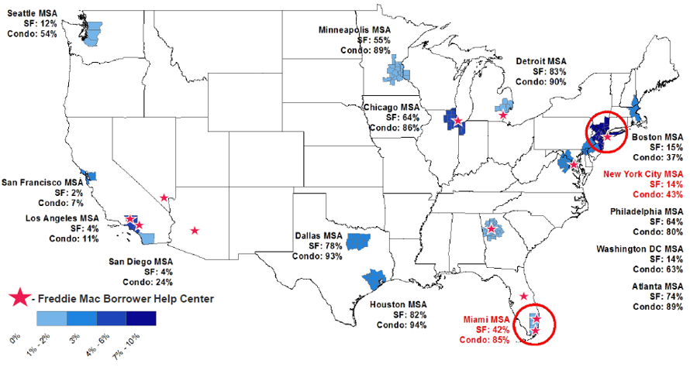
Affordability Is a Challenge in Many Areas
Sources: Experian data, Freddie Mac analysis

Slide 29
Generation X Is Comparatively Small But Still Important
26% of the 2015 purchase market
26% were first-time homebuyers in 2015
Many buy for more space
~20% have children younger than 18 living at home
Many carry student debt
Source: National Association of Realtors March 2016 report, “Home Buyers and Sellers Generational Trends”

Slide 30
Baby Boomers Control the Market
1/4 of the U.S. population
69 million own homes
2/3 of the equity in single-family homes
63% want to age in place
40% plan to move at least once; 13% within 4 years
Source: Freddie Mac 55+ Survey

Slide 31
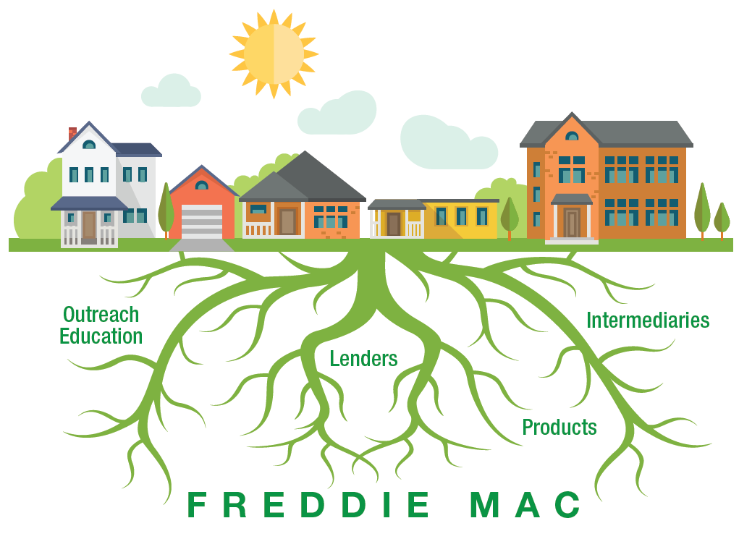
We Can Grow Responsible, Sustainable Affordable Lending – Together

Slide 32
Raymond Leech Community Lending CDT Fannie Mae

Slide 33
Edward Bartholomew President EDC Warren County

Slide 34
Charles Kilbourne Trustee The Wright Family Foundation

Slide 35
Power Through Partnership
Statewide conference
Thursday, September 28, 2017

Slide 36
Sherri Eckles Senior Vice-President SONYMA

Slide 37
Gabe del Rio President Nationwide Mortgage Collaborative

Slide 38
Partner Overview
Springboard CDFI background and Nationwide Mortgage Collaborative

Slide 39
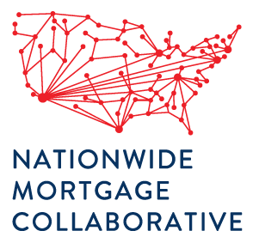
Springboard CDFI
Bridging the wealth gap in America by providing scaled solutions and access to capital; with a focus on first time homebuyers, people of color, and rural communities.
founded in 1982, now a National CDFI Mortgage Bank

Slide 40
http://mortgagecollaborative.org
90-second Video on NMC
MortgageCollaborative.org

Slide 41
The Broken Delivery System for LMI
Non-Profits need more revenue, and their programs rely on local relationships with few loan officers that often don’t have the time or incentive model to serve LMI borrowers or complex DPA loans at any scale.
Banks struggle to manufacture LMI loans at a reasonable cost given the new regulations and niche market-based programs.
CRA motivated investors and the CDFIs & other originators of those loan products don’t exist in all areas of the country – with Mortgage Brokers having been all-but regulated-out of the industry.
Borrowers with loans less than $100K struggle to find any lender willing to assist them with a loan, and minority communities devastated by the foreclosure crisis remain the least served.
$7,400+ Cost/Loan
Loan Officer Comp Plans
“No” to loans under $100K
Affordable Homes Bought by Investors
DPA + LMI + FTHB = More Work
CRA Not Present Everywhere
MortgageCollaborative.org

Slide 42
Springboard CDFI is uniquely positioned to lend on behalf of the following national banks and over 20 other investors; with solutions for local & regional bank partners:
-and we provide that platform to partners, dba as Nationwide Mortgage Collaborative – so you can have that same access!
MortgageCollaborative.org

Slide 43
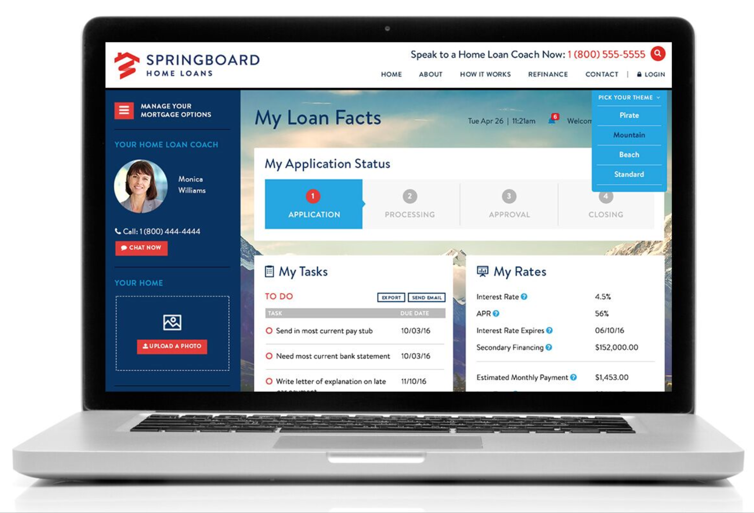
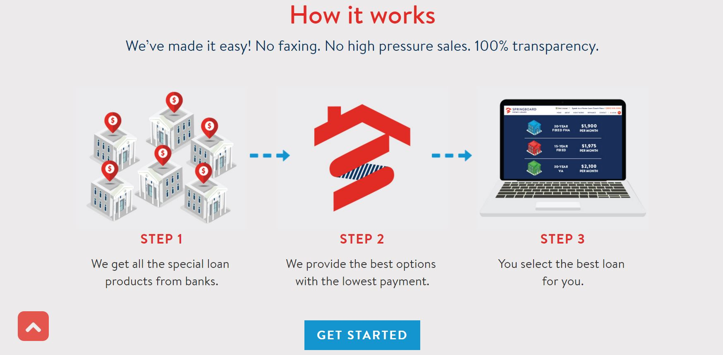
Bank CRA Loans, Conventional, FHA, VA, USDA, and Specialty Affordable Loans – All in One Place
Coming Soon (end of 2017):
ITIN / Foreign National
Reverse Mortgages if we see strong member demand
MortgageCollaborative.org

Slide 44
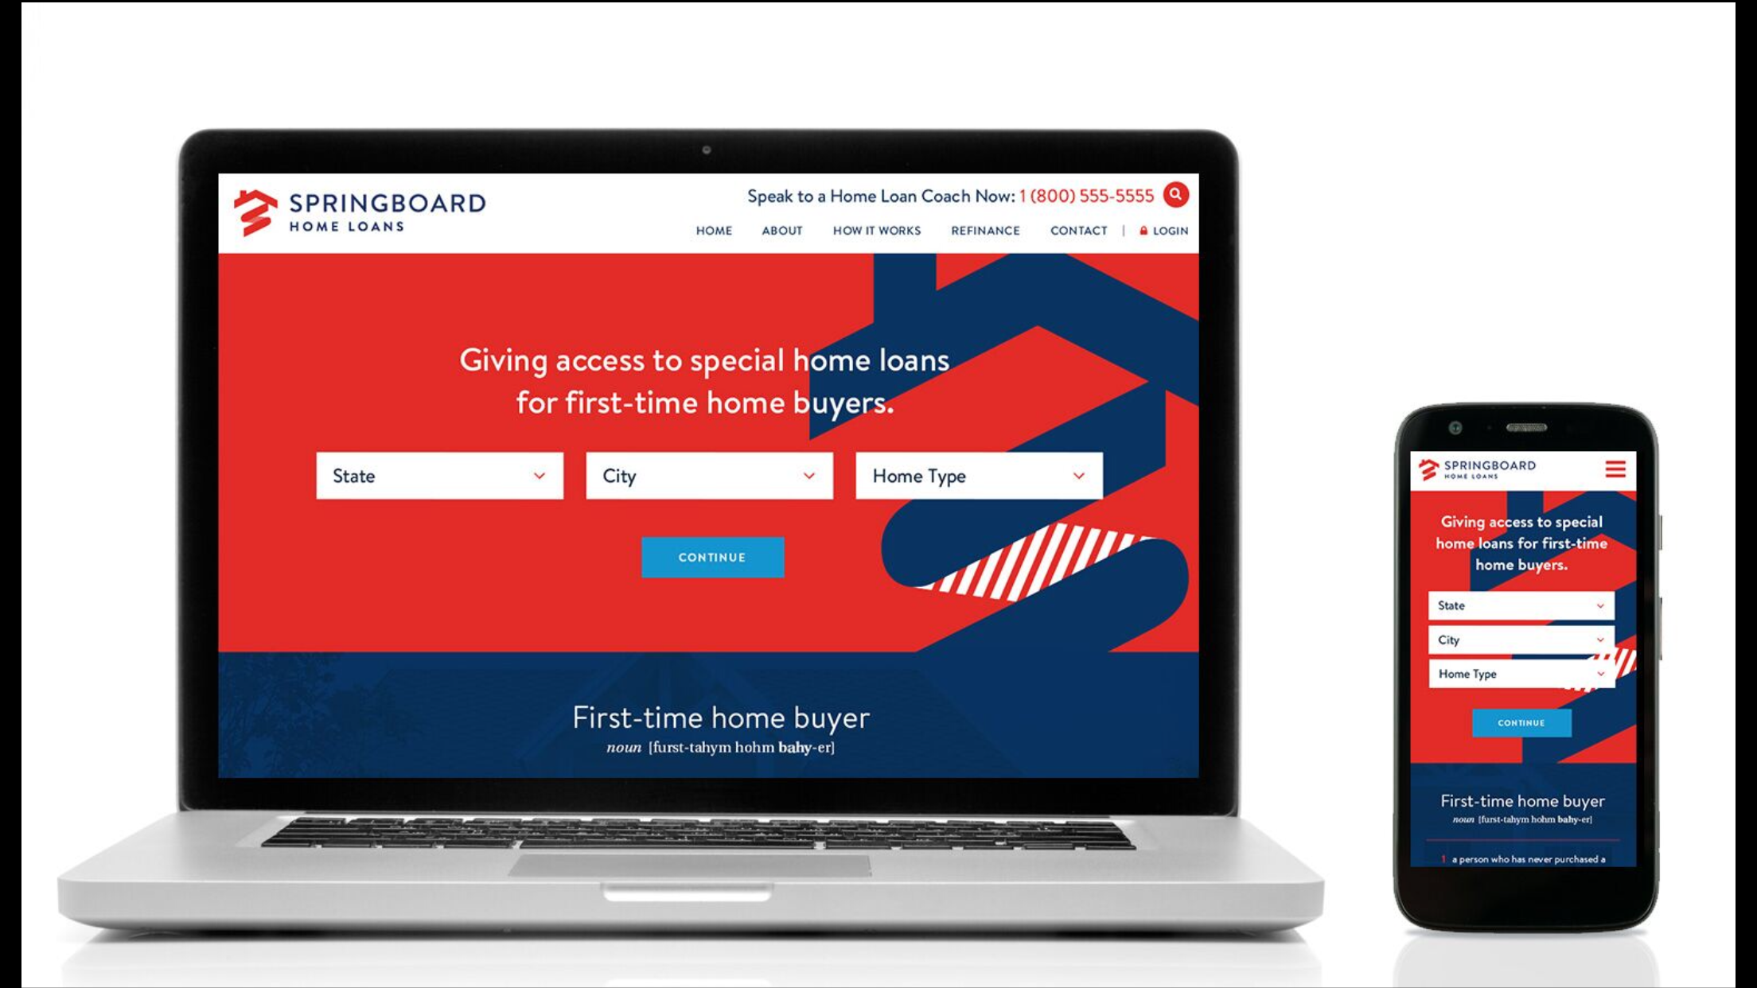
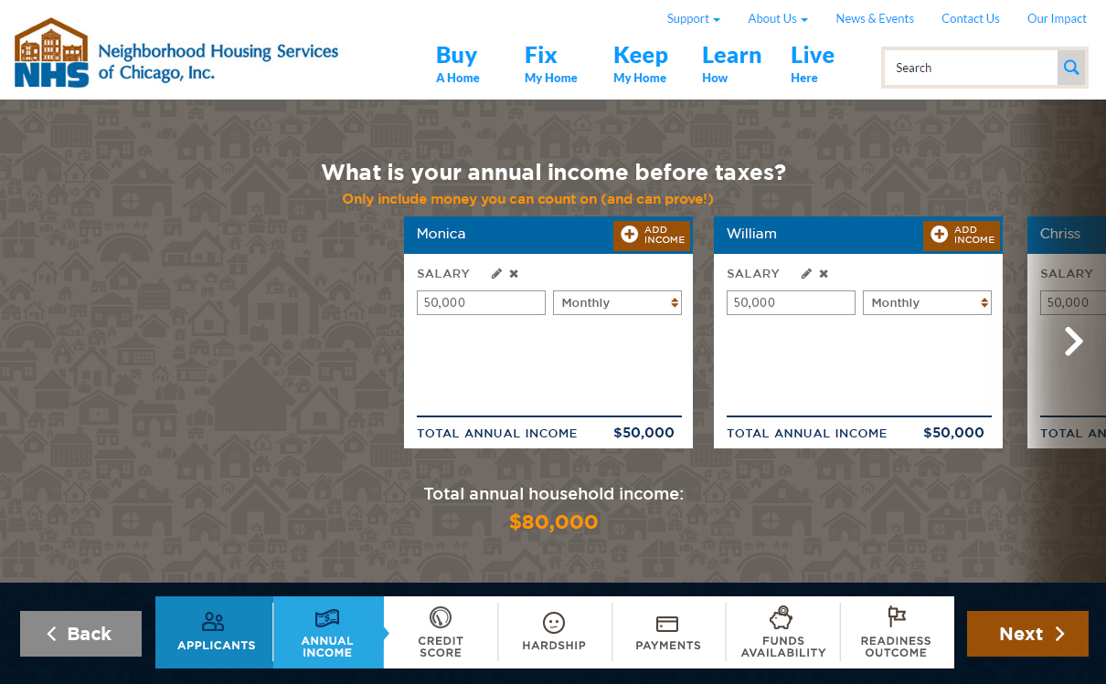
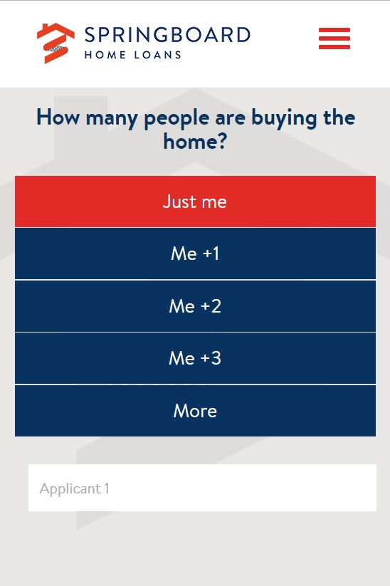
Marketing Tool Kit for NMC Members
Mortgage Readiness, Loan Shopping Tool, Application/Intake,
and other resources available for member use.
Includes: Press Release, Videos, Flyers, Info-graphics, and Social Media Tools
MortgageCollaborative.org

Slide 45
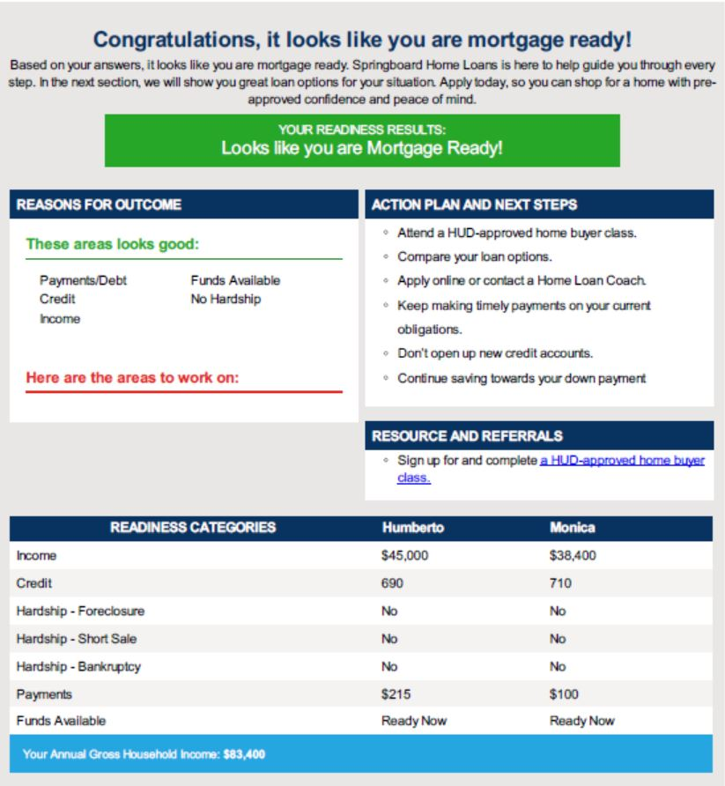
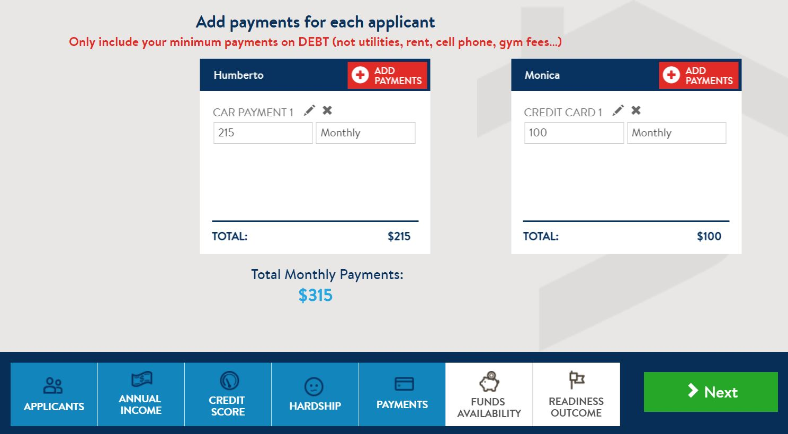
Mortgage Readiness
Easy, Useful, Engaging
Y viene tan pronto completamente en Español!
Retail Example SHOWN
MortgageCollaborative.org

Slide 46
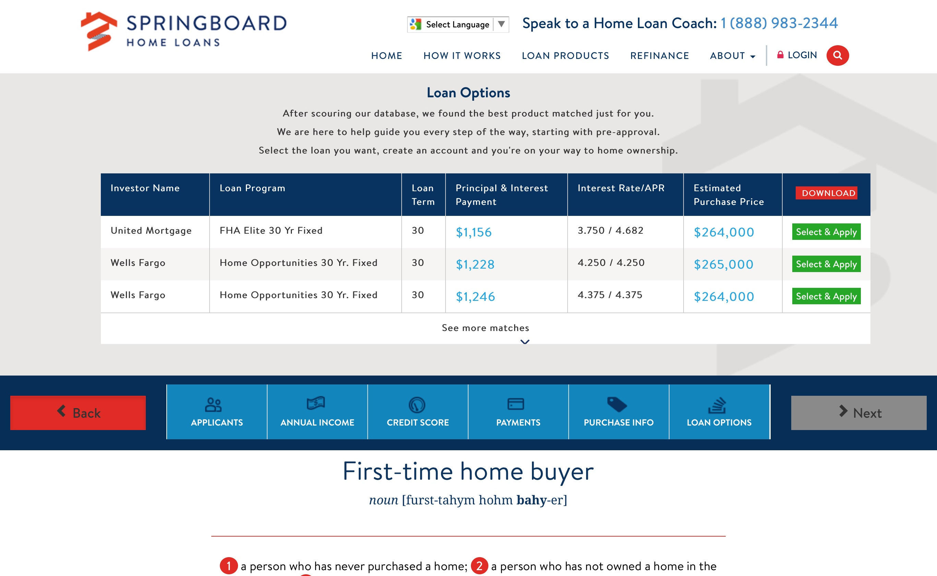
Loan Shopping Tool
Product & Pricing Search Engine
Retail Example SHOWN

Slide 47
Marketing with
State of the Art Technology
Let’s jump on www.mortgagecollaborative.org and walk through the tools that NMC members can have customized to their brand.
This and other NMC marketing tools & resources, helps our partners:
engage more clients
triage for services
demonstrate your value proposition
MortgageCollaborative.org

Slide 48
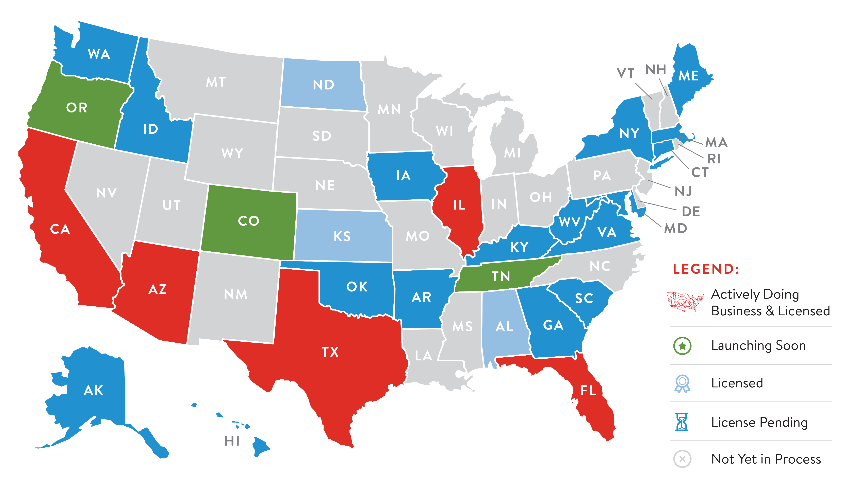
Springboard CDFI Licensing & NMC Activity Map
MortgageCollaborative.org

Slide 49
NMC Leadership Council
Established in 2013 by the Ford Foundation; now hosted and powered by Springboard CDFI to work with the field as a capital aggregator and technology based solutions provider.
MortgageCollaborative.org

Slide 50
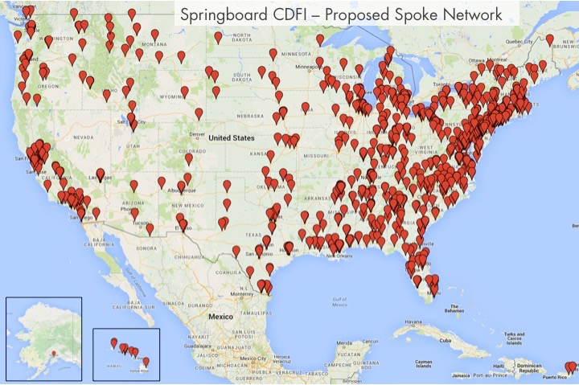
NMC Counseling Partners – Pilot
We are targeting over 800 HUD-Approved Organizations & CDFIs focusing on first time home buyer preparation, coordinating with existing networks and working with individual organizations. Visit the website for more information and stay tuned for state by state platform launches with partners…
MortgageCollaborative.org

Slide 51
Power Through Partnership
Statewide conference
Thursday, September 28, 2017

